Slide 1
SOFTWARE PROJECT MANAGEMENT
Development Management
Dr. Seemab Latif
Lecture No. 12
26th April, 2011

Slide 2
Capability Maturity Model: CMM
A software process framework
“Process determines capability”
5 ‘maturity’ levels
    ‘Evolutionary plateaus’ to a mature software process
Each level has its own goals
Organizations can be certified
  Later to be used as a marketing or validation tool

Slide 3
Maturity Concept
Software process
  a set of activities, methods, practices, and transformations that people use to develop and maintain software and the associated products
Software process capability
  the range of expected results that can be achieved by following a software process
Software process performance
  the actual results achieved by following a software process.
Software process maturity
  the extent to which a specific process is explicitly defined, managed, measured, controlled, and effective (implies a potential for growth in capability and indicates both the richness of process and the consistency with which it is applied

Slide 4
Institutionalization
As a software organization gains in software process maturity, it institutionalizes its software process via policies, standards, and organizational structures.
Institutionalization entails building an infrastructure and a corporate culture that supports the methods, practices, and procedures of the business so that they endure after those who originally defined them have gone.

Slide 5
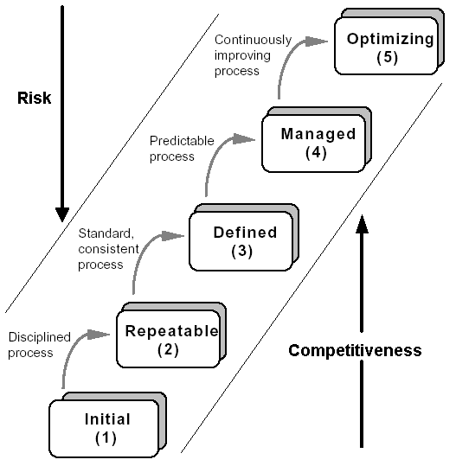
SW-CMM Levels
Software Process Maturity Levels

Slide 6
SW-CMM Levels
Initial
  The software process is characterized as ad hoc, and occasionally even chaotic. Few processes are defined, and success depends on individual effort and heroics.
Repeatable
  Basic project management processes are established to track cost, schedule, and functionality. The necessary process discipline is in place to repeat earlier successes on projects with similar applications.
Defined
  Management and engineering activities are documented, standardized, and integrated into a family of standard software processes for the organization. Projects use a tailored version of the organization’s standard software processes for developing and maintaining software.

Slide 7
SW-CMM Levels
Managed
  Detailed measures of the software process and product quality are collected. Software processes and products are quantitatively understood and controlled.
Optimizing
  Continuous process improvement is facilitated by quantitative feedback from the process and from piloting innovative ideas and technologies.
Level 4 and 5 are usually considered “high maturity” levels

Slide 8
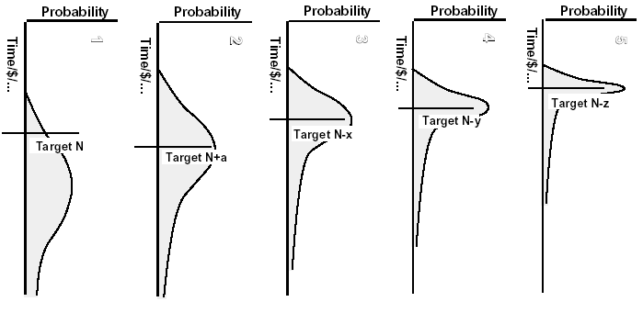
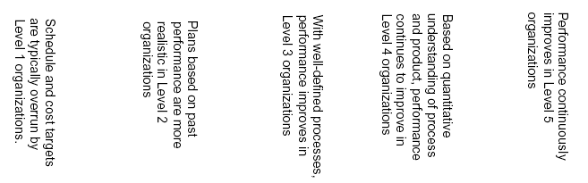
Process Capability vs. Maturity

Slide 9
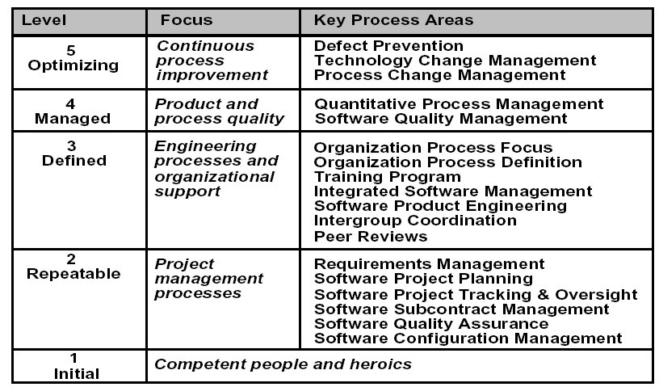
Key Process Areas

Slide 10
CMM Structure
Maturity Levels
Key Process Areas
Goals
Common Features
Key Practices

Slide 11
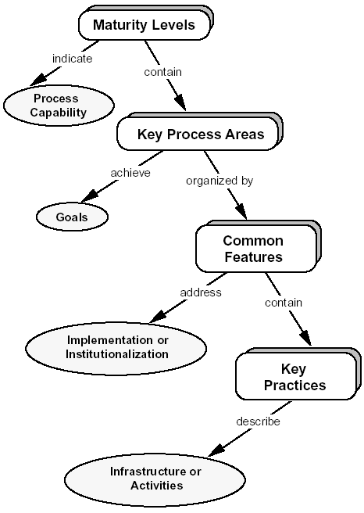
CMM Structure

Slide 12
KPA Goals
L-2, requirements management
  Controlled requirements as baseline for activities
  Consistent plans, procedures, and activities
L-2, project planning
  Documented estimates
  Planned activities
  Agreed commitments
L-2, software tracking and oversight
  Results tracked against plans
  Corrective actions
  Agreed changes to commitments

Slide 13
KPA Goals
L-2, subcontract management
    Qualified subcontractors selected by prime contractor
    Agreed commitments
    Ongoing communications
    Performance tracking
L-2, quality assurance
    Planned QA activities
    Verified adherence to procedures
    Informed groups and individuals
    Noncompliant issues addressed by project members or senior management
L-2, configuration management
    CM activities planned
    Identified, controlled, and available items
    Change control
    Groups informed of status and content of baselines

Slide 14
KPA Goals
L-3, organization process definition
  Standard software process
  Available information
L-3, organization process focus
  Coordinated development and improvement activities
  Process standard used to identify strengths and weaknesses
  Planned organization-level improvement activities
L-3, Training
  Planned training activities
  Necessary trainings received

Slide 15
KPA Goals
L-3, integrated software management
  Tailored process for each project
  Projects planned and managed based on their process
L-3, software product engineering
  Defined and integrated tasks
  Consistent work products
L-3, inter-group coordination
  Agreed customer's requirements
  Agreed commitments
  Identified, tracked, and resolved inter-group issues.
L-3, peer review
  Planned activities
  Identified and removed defects

Slide 16
KPA Goals
L-4, quantitative process management
  Planned activities
  Quantitative performance control for project processes
  Quantitative identification of standard process capabilities
L-4, software quality management
  Planned activities
  Measurable quality goals
  Quantified and managed progress

Slide 17
KPA Goals
L-5, defect prevention
  Planned activities
  Identified common causes of defects
  Prioritized and removed causes
L-5, technology change management
  Planned activities
  Evaluated effect on quality
  Transferred into normal practice if appropriate
L-5, process change management
  Planned activities
  Organization wide participation in process improvement
  Standard and project processes continuously improved

Slide 18
KPA Common Features
Commitment to perform
  Senior management policies
Ability to perform
  Training, special skills & tools
Activities performed
  Plans and procedures
Monitoring
  Measurement and analysis
Verification
  Reviews and audits

Slide 19
Examining Maturity Level
CMM Assessment
  Voluntary and confidential
  Inspects the organization-wide capability/maturity
  Done by senior professionals and one or two coach
    Coaches are from SEI or an SEI-licensed assessment vendor
CMM Evaluation
  Open to external inspecting body
  Usually for getting a contract
  Done by external contractor
  Very judgemental and stressful

Slide 20
CMM Assessment
Procedure
  Obtain commitment of organization
  Preparation
  Assessment conduct (interview, data collection, analysis)
    Usually in 3 or 4 days
  Briefing and reporting
  Action plan development
  Follow-up
Teams/Personnel
  Assessment team
  Senior management
  Software project managers (SPMs)
  Functional area representatives (FARs)
    Developers, QA and CM engineers, members of Software Engineering Process Group (SEPG)

Slide 21
Brain Storming
India has more CMM level 4 & 5 companies than any other country
  Why is that?
  Case study

Slide 22
How many companies in Pakistan are CMMi level 5 certified?
Sr. | Company Name | CMM Level
1. | NetSol Technologies (Pvt.) Ltd. | CMMI Level 5
2. | NCR Pakistan | CMMI Level 5
3. | Kalsoft (Pvt.) Ltd. | CMMI Level 3
4. | Systems (Pvt.) Ltd. | CMMI Level 3
5. | Digital Processing Systems | CMMI Level 3
6. | ZTE Pakistan, Software R &amp; D Center | CMMI Level 2
7. | Eworx Intl (Pvt.) Ltd. | CMMI Level 2
8. | Techlogix Pakistan (Pvt.) Ltd. | CMMI Level 2
9. | Si3 - System Innovations (Pvt.) Ltd. | CMMI Level 2
10. | Abacus Consulting (Pvt.) Ltd. | CMMI Level 2
11. | Descon Information Systems | CMMI Level 2
12. | E-Dev Technologies | CMMI Level 2
13. | Prosol Technologies | CMMI Level 2
14. | Avanza Solutions | CMMI Level 2
15. | Geopaq Technologies | CMMI Level 2
16. | Advanced Computing and Engineering Solutions | CMMI Level 2
17. | Technosoft Solutions (Pvt) Ltd | CMMI Level 2
18. | Prislogix | CMMI Level 2
19. | CARE (Center for Advanced Research in Engineering) Pvt. Ltd. | CMMI Level 2

Slide 23
Tools
Requirements Tools
Design Tools
Construction Tools
Test Tools
Maintenance Tools
CM Tools

Slide 24
Tools
Tools could save 10-25% on some projects
  But that’s optimistic at best
Choose tools to meet your needs
No tool can guarantee you anything
  They *may* help
  Tools don’t control people, especially customers

Slide 25
Requirements
Requirements are capabilities and condition to which the system – more broadly, the project – must conform

Slide 26
Requirements
Perhaps most important & difficult phase
Shortchanging it is a ‘classic mistake’
Can begin with a Project Kickoff Meeting
Can end with a Software Requirements Review (SRR)
  For Sponsor and/or customer(s) approval

Slide 27
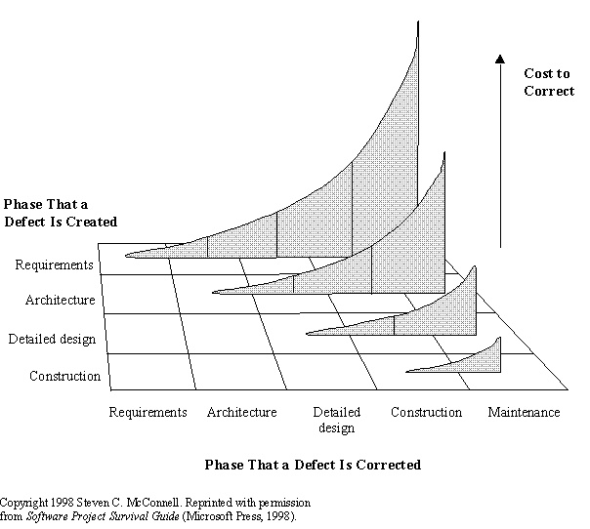
Why are Requirements so Important?

Slide 28
Requirements
Characteristics & Issues
  Conflict of interest: developer vs. customer
  Potential tug-of-war:
    Disagreement on Features & Estimates
    Especially in fixed-price contracts
  Frequent requirements changes
  Achieving sign-off
Project planning occurs in parallel

Slide 29
2 Types of Requirements
  Functional (behavioral)
      Features and capabilities
  Non-functional (a.k.a. “technical”) (everything else)
      Usability
        Human factors, help, documentation
      Reliability
        Failure rates, recoverability, availability
      Performance
        Response times, throughput, resource usage
      Supportability
        Maintainability, internationalization
      Operations: systems management, installation
      Interface: integration with other systems
      Other: legal, packaging, hardware

Slide 30
Requirements
Must be prioritized
    Must-have
    Should-have
    Could-have (Nice-to-have: NTH)
Must be approved

Slide 31
Requirements
Used by many people for many purposes
Purposes
  Management: Yes, that’s what I funded
  Users: Yeah, that’s what I need
  Developers: Yes, that’s I will build

Slide 32
Requirements
The “What” phase
Inputs: SOW, Proposal
Outputs:
  Requirements Document (RD)
    a.k.a.Requirements Specification Document (RSD)
    Software Requirements Specification (SRS)
  1st Project Baseline
  Software Project Management Plan (SPMP)
  Requirements Approval & Sign-Off
    Your most difficult task in this phase

Slide 33
Requirements
“There’s no sense being exact about something if you don’t even know what you’re talking about” John von Neumann
“When the map and the territory don’t agree, always believe the territory”, taught to all Swedish army recruits
Notes:
No lab today
More lab in later term

Slide 34
Requirements Gathering Techniques
Interviews
Document Analysis
Brainstorming
Requirements Workshops
Prototyping
Use Cases
Storyboards
There are more…

Slide 35
Interview Techniques
Best practice: use ‘context free’ questions
  A question that does not suggest a response
  High-level, early questions to obtain ‘global’ properties of the problem and solution
  Applicable to any project/product
  Get the ball rolling

Slide 36
Context-free Questions
Process, product and meta questions
Process
  “Who is the client for project X”?
  “What is a very successful solution really worth to the client”?
  “What is the reason for this project”?
Product
  “ What problems does this system solve”?
  “What problems could this system create”?
Meta-questions
  “Are these questions relevant”?
  “Is there anyone else who can give useful answers”?
  “Is there anything you want to ask me”?

Slide 37
Document Analysis
Review of existing documents
    Business plans
    Market studies
    Contracts
    Requests for proposals (RFP)
    Statements of work (SOW)
    Existing guidelines
    Analyses of existing systems and procedures

Slide 38
Brainstorming
Idea generation & idea reduction
Typically via group meetings
Generation Best practices
    Minimize criticism and debate
      Editing occurs at end of meeting or later
    Aim for quantity
    Mutate or combine ideas
Reduction best practices
    Voting with a threshold (N votes/person)
    Blending ideas
    Applying criteria
    Scoring with a weighting formula

Slide 39
Requirements Workshops
Typically 1-5 days
Who? Varies. Users & stakeholders
Pros
  Good for consensus building
  Builds participant commitment
  Can cost less than numerous interviews
  Provide structure to capture and analysis process
  Can involve users across organizational boundaries
  Can help identify priorities and contentious issues
JAD
  A type of requirements workshop using a facilitator

Slide 40
Prototyping
Quick and rough implementation
Good communications mechanism
Can be combined with other techniques such as JAD
Issues: creating the mis-appearance that development is more complete than it actually is

Slide 41
Use Cases
Picture plus description
Often misunderstood: the text is more important
Diagrams
Text structure
    Use case name and number (ID)
    Goal
    Pre-conditions
    Primary & secondary actors
    Trigger
    Description
    Business rules
    Open issues
For good examples, see usecases.org

Slide 42
Storyboards
Set of drawings depicting user activities
Paper prototyping
Drawing screens or processes

Slide 43
Requirements: Who?
Customers and users (note: often not the same)
    Customers can be users, but rarely opposite
    Sometimes user constituencies need to be ‘found’
Subject matter experts
Other stakeholders
  Marketing, sales
  Product managers

Slide 44
Other Requirements Tips
Meetings
  Treat them like a tool: design them
  Boy scout motto: “Be Prepared”
  As small as possible – but no smaller
  Make it safe not to attend
    Publish an agenda before
    Publish a summary after
  Generate a ‘related issues’ list
  Can formal/informal, scheduled/ad-hoc

Slide 45
Other Requirements Tips
Manage expectations
  Don’t forget to ask people theirs
  Listen
  Make explicit otherwise implicit decisions
    PDA: Possibility, Deferred, Absolutely impossible
Technical reviews
  Requirements can be wrong by: inadequate or inaccurate
    Quantity & quality
  Reviews help with the latter

Slide 46
Requirements Tools
Databases of requirements
Displayable in various formats
Optional requirements control metrics:
    To help manage feature creep and ‘vibration’

